Slide 1
Architectural & Engineering Designer Symposium
Tuesday, February 14, 2012
Student Activity Center, Salons C - E

Slide 2
Agenda
Facilities Management Team Introductions, Roles, & Areas of Consultant Assistance
6-Year Plans
Repair & Renovation Plans
Capital Projects – Completed, Started & Coming Soon
Designer Selection Process
Open-End Selection Process

Slide 3
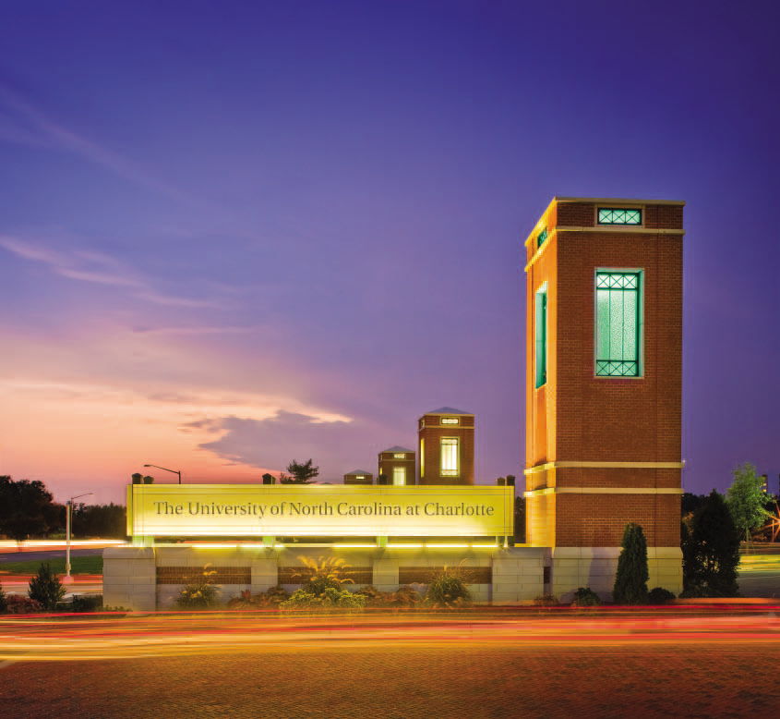
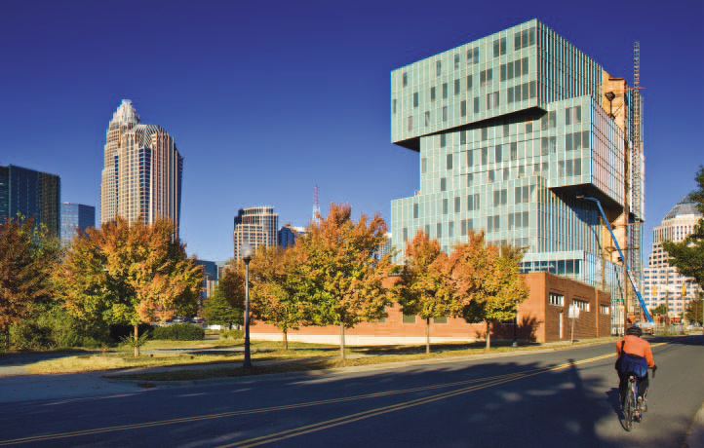
Welcome
Philip Jones Associate Vice Chancellor
Beverly Imes Executive Assistant
John Fessler Capital Projects (15 Positions)
Lee Snodgrass Facilities Operations (191 Positions)
Ray Dinello Facilities Information Systems (6 Positions)
Peter Franz Real Estate and Land Use (4 Positions)
Chris Gilbert Architectural Planning (4 Positions)
Melanie Witherspoon Facilities Business Office (8 Positions)
Mac Fake Design Services (13 Positions)
Brian Guns Housekeeping and Recycling (150 Positions)
Welcome - Phil Jones, PE, Associate Vice Chancellor
Design Guidelines

Slide 4
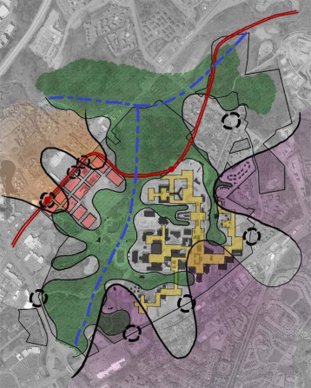
The Teams & Duties
Real Estate and Land Use – Peter Franz, RLA, LEED AP, CEFP
The RE/LU Team
Responsibilities / Role (Master Planning, Sustainability, Transportation, Stormwater, Sector Studies, Real Estate)
Consultant Help – Studies (Open End & Advertise)
Design Services – Mac Fake, AIA
The Design Services Team
Responsibilities / Role
Projects less than $500,000 (informal)
In house design capabilities ( Consultant Help--Open end)

Slide 5
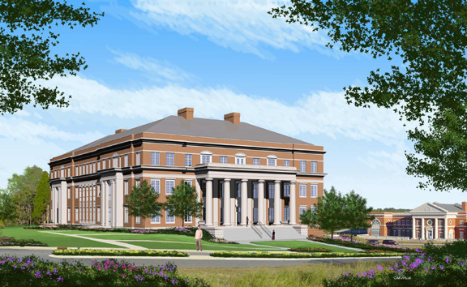
Team & Duties
Architectural Planning – Chris Gilbert, AIA
The AP Team
Responsibilities / Role
Consultant Help – Programming (Open End & Advertise)
Capital Projects – John Fessler, PE
The Capital Team
Responsibilities / Role
Projects greater than $500,00 (formal)
Consultant Help - Design & Construction Admin (Advertise)
Consultant Help - Commissioning (Advertise)
Consultant Help - Material Testing (Open End, Advertise)

Slide 6
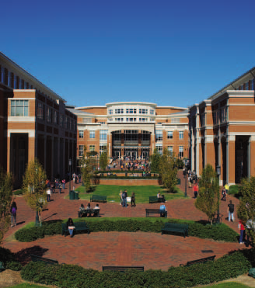
6 Year Capital Plan
(AIA)
Appropriated Projects – On hold
Science Building
Burson Building Modernization & Expansion
Arts and Humanities Building
Physical Plant Complex
Student Health and Wellness Center
Student Academic Success & Retention Centerr

Slide 7
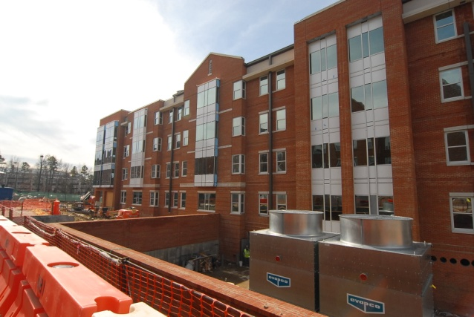
6 Year Capital Plan
Non-Appropriated Projects
Cafeteria Activities Building Renovation
Sanford Hall Renovation
Residence Hall Phase 13
Football Exterior Lighting
Martin Village Demolition
Parking Deck K
Hawthorn Renovation
Moore Hall Renovation

Slide 8
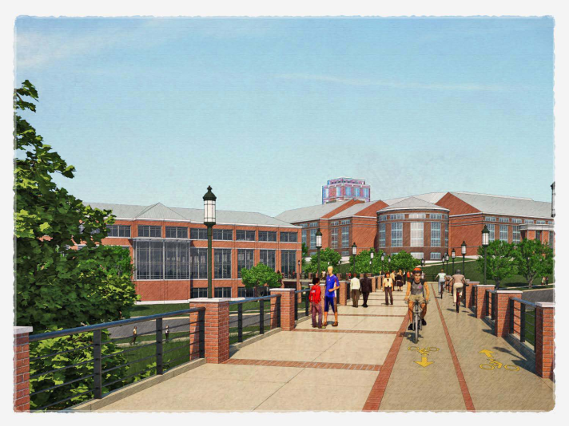
Repair and Renovation (R&R)
R&R projects are intended to repair, modernize
and/or replace existing infrastructure, buildings,
and systems.
The Campus Infrastructure Development (CID) Capital
Project will largely include R&R items normally covered
by R&R appropriations.

Slide 9
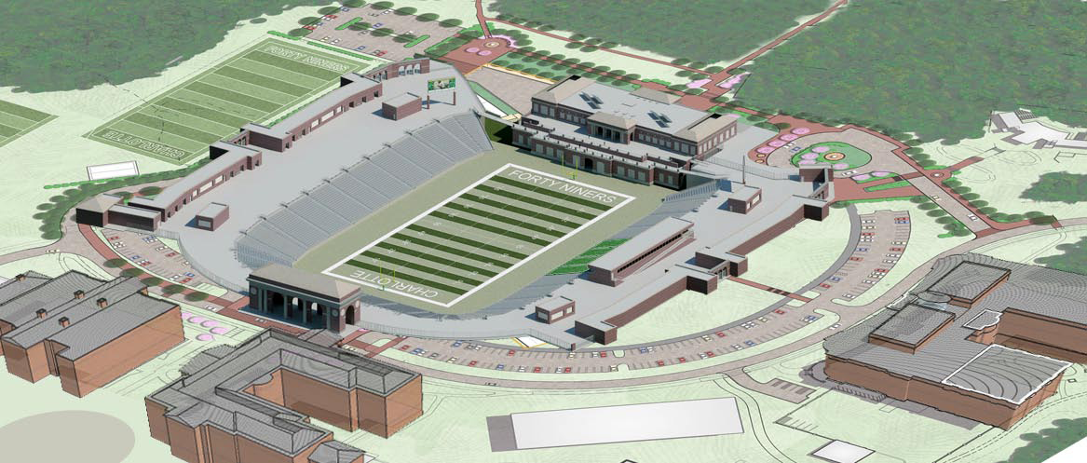
Design & Construction Guidelines
Consultants, contractors, and University staff are
subject to the Facilities Management Design and
Construction Manual for the design, construction,
and renovation of University-owned facilities.
The Design and Construction Manual follows the
Master Spec organization and is posted on the FM
website at http://facilities.uncc.edu

Slide 10
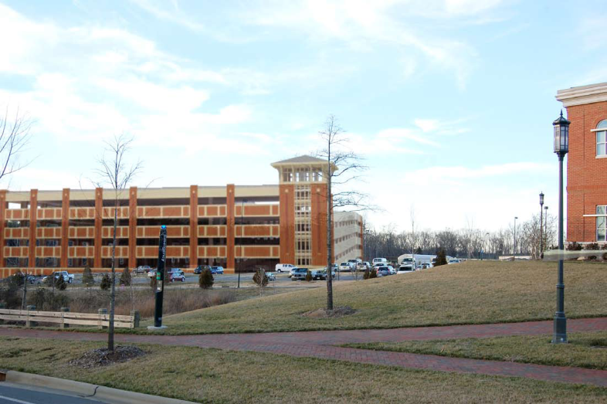
Completed Capital Projects
New Tennis Courts Phase I – January
Outdoor Student Recreational Facility – March
Residence Hall, Phase 9 – July
Parking Deck H – July
Prospector Phase 2 – June
Center City Classroom Building – August
Motorsports Building II – October
Relocation of Rec Fields 8 & 9 – November

Slide 11
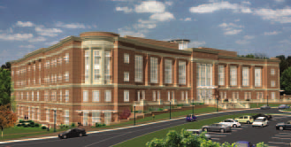
Capital Projects Started 2011
New Tennis Phase II – ETA February 2012
EPIC – ETA March 2012
Football – ETA August 2012
Parking Deck I – ETA September 2012
Residence Hall Phase I0 – ETA June 2013
PORTAL – ETA June 2013
South Village Development – ETA vary

Slide 12
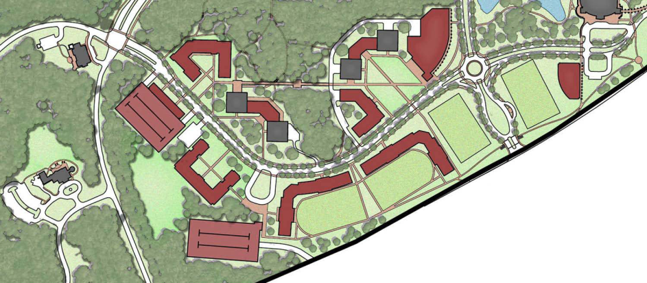
Capital Projects Started in 2011 (Continued)
South Village Development – “major projects”
Residence Hall Phase 11 – ETA June 2013
Regional Utility Plant 4 – ETA May 2013
Parking Deck J – ETA July 2013
Residence Dinning Hall – ETA December 2013
High Rise Road – ETA December 2012

Slide 13
Capital Projects Started in 2011 (Continued)
South Village Development – “minor projects”
Demolish Hunt Village
Fire Protection Scott Hall
Repair Heckenbleikner Dam
Repair Front Entrance Round-about
?

Slide 14
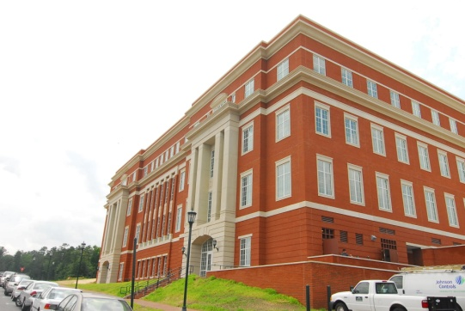
Design Selection Process
Rules – 01 NCAC 30D Qualifications Based Selection Process
Specialized or appropriate expertise in the type of project.
Past performance on similar projects.
Adequate staff and proposed design or consultant team for the project.
Current workload and State projects awarded.
Proposed design approach for the project including design team and consultants.
Recent experience with project costs and schedules.
Construction administration capabilities.
Proximity to and familiarity with the area where project is located.
Record of successfully completed projects without major legal or technical problems.
Other factors that may be appropriate for the project.

Slide 15
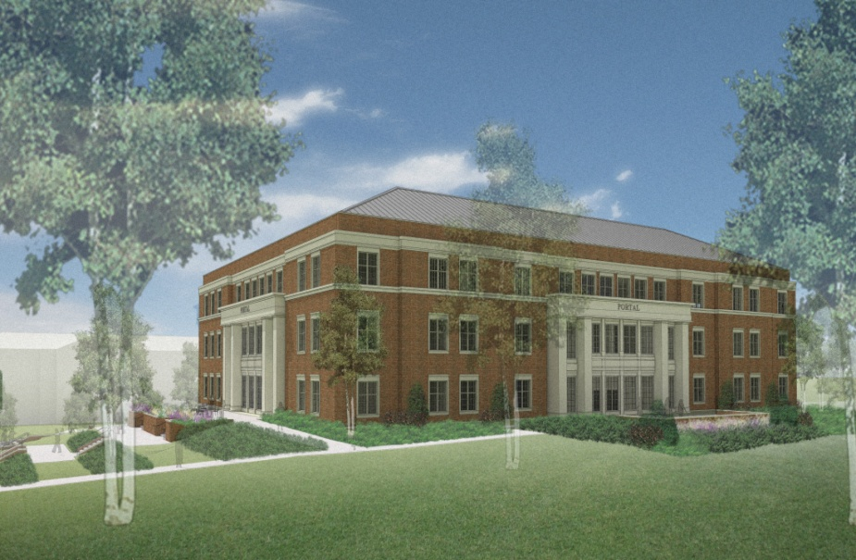
Design Selection Process
Steps/Process
Advertise - UNCC & General Administration websites; Interactive Purchasing System Site (IPS)
Proposal Screening Committee – Shortlist 3-5 firms for presentations & interview
Evaluate proposals
FM, Capital and
Customer Department

Slide 16
Design Selection Process
Interview Committee – Selects Best Qualified
Board of Trustee Chair
VC BA, AVC FM, Senior Department Leader Members
Capital Coordinator (PE/AIA) Member
Staff Advisors Attendees
Board of Trustees – Approves Recommendation
Capital Coordinator – Negotiates Agreement & Manages Design thru Closeout

Slide 17
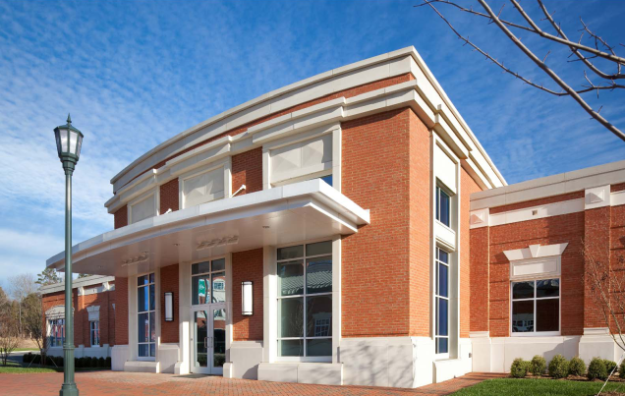
Open-end Selection Schedule
Advertise – July
Evaluate – August/September
Select – September/October
BOT Approves – November
Selected Firms Notified – December
Contract – January thru December

Slide 18
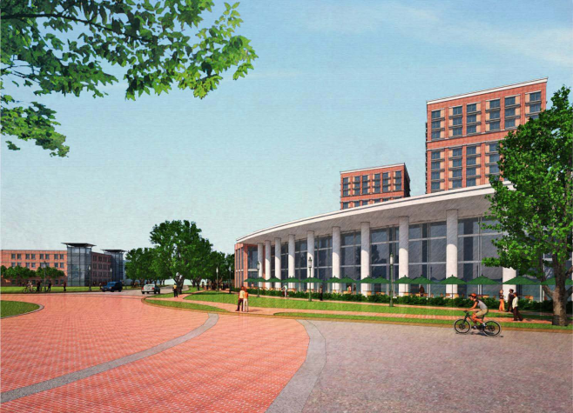
Open-end Selection Process
General Information & History
Seven Categories (Architecture, CE, MEP, Construction Services, Commissioning, Surveying, Transportation)
140 Submittals Received for 2012 (Architecture-40 & CE/Site-33)
Past Value of Work: 2011- $456k (37); 2010 - $1M+ (65); 2009 - $450k (31); 2008 - $711k (48); 2007 - $695k (52)
SF 254/255: Page limits, follow directions, attend pre-proposal meeting, local capacity, related experience.

Slide 19
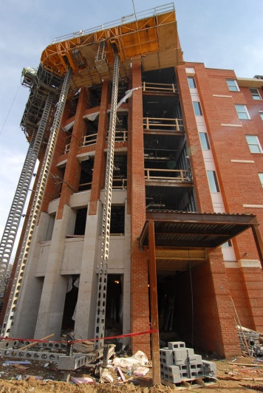
Website Information
Facilities Management
http://facilities.uncc.edu/
http://facilities.uncc.edu/advertisements
State Construction Office
www.nc-sco.com
UNC System
www.northcarolina.edu/info/vendors/opportunities.htm
Interactive Purchasing System (IPS)
www.doa.state.nc.uspandc

