Slide 1
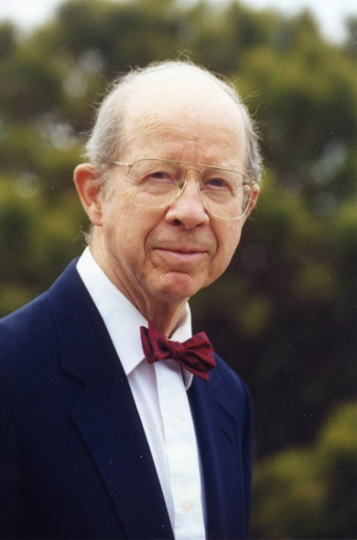
Burson Building Renovation
Overview of Project Needs
Department of Chemistry
Sherman L. Burson, Jr.
December 24, 1923 – December 3, 2012
Bernadette Donovan-Merkert, Professor and Chair of Chemistry
December 6, 2012

Slide 2
Department of Chemistry: Today
14 tenured/tenure track faculty, 8 lecturers
8.5 staff members
300 undergraduate Chemistry majors
22 Master’s students
18 Doctoral students
Large service teaching load
2,457 lecture students (Fall 2011)
1,456 lab students (Fall 2011)

Slide 3
Department of Chemistry: The Future
20-30 tenured/tenure track faculty, 10 lecturers
12-15 staff members
400 undergraduate Chemistry majors
20-25 Master’s students
25-30 Doctoral students
Larger enrollments in lecture and laboratory
courses (more sections will be needed)
Expect 3% growth per year

Slide 4
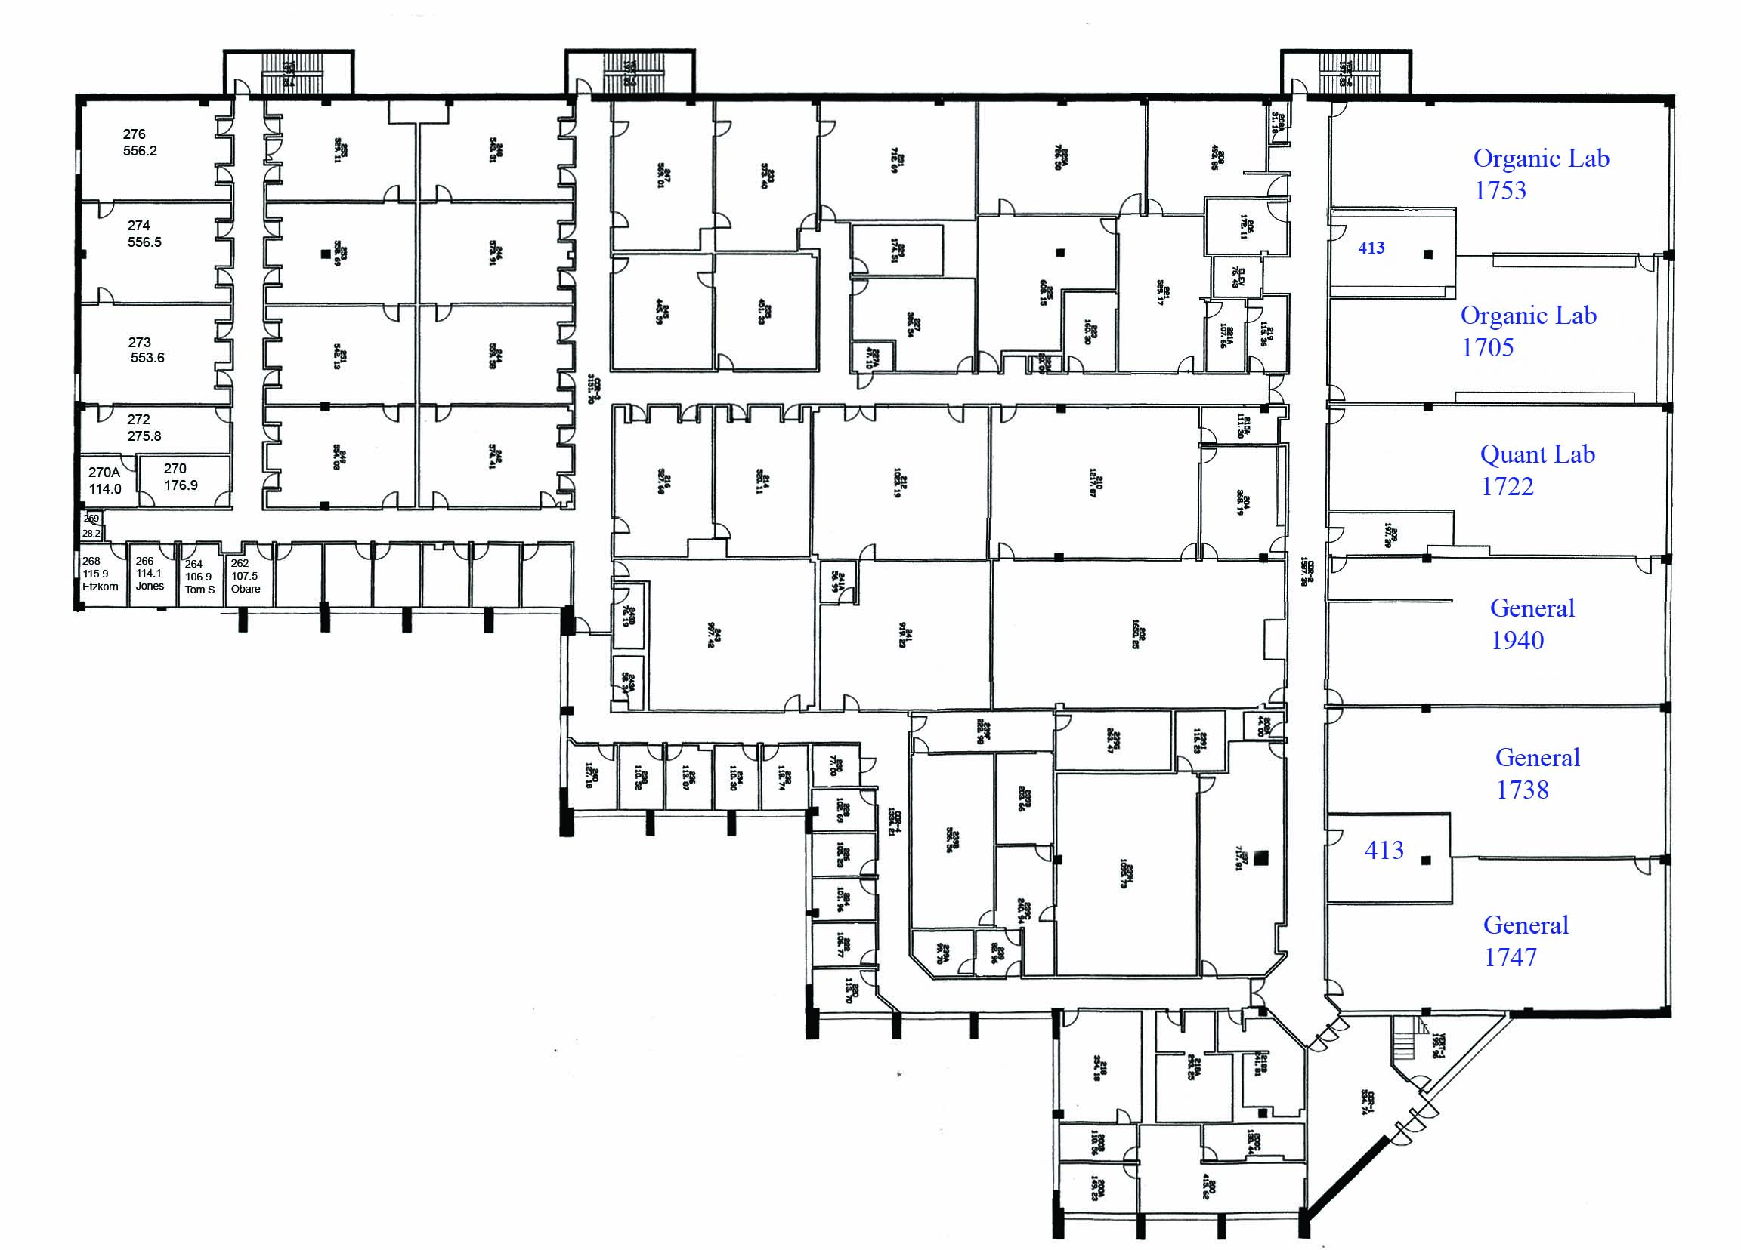
Burson Building: Second Floor

Slide 5
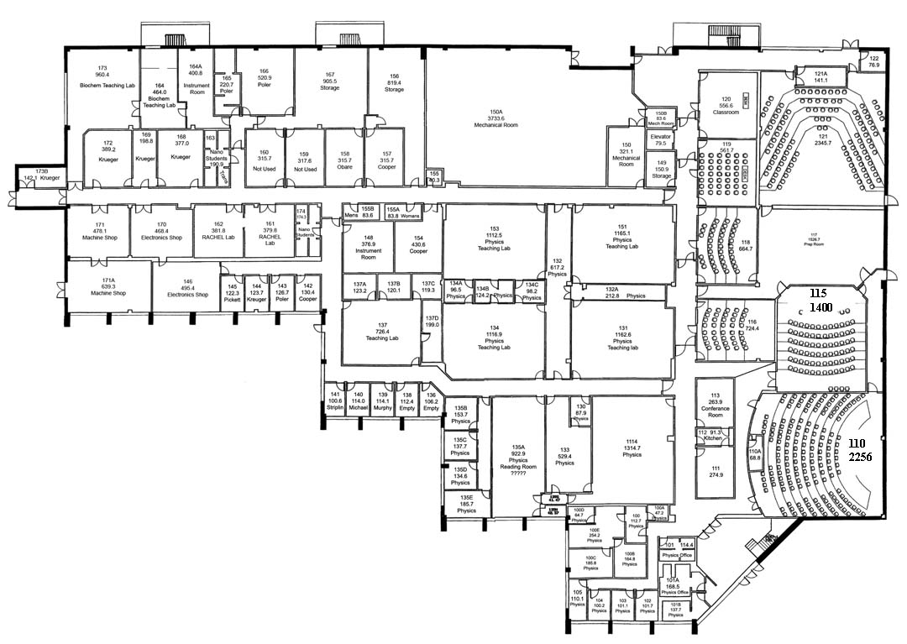
Burson Building: First Floor

Slide 6
Issues to address: Teaching
More laboratory teaching space needed for
“General” laboratories
More laboratory teaching space needed for
“Organic” chemistry laboratories
Bring organic chemistry laboratories to modern
safety levels
Lecture halls modernized and capacity increased
Possibly increase capacity of advanced
level labs

Slide 7
Issues to address: Research
More research space needed to accommodate
new faculty hires (6-7 additional faculty by 2020)
More laboratory space needed for existing faculty
(workbench/instrument space and student desk
space (graduate and undergraduate students))
Common student areas needed

Slide 8
Issues to address: Stockroom
Increase stockroom capacity to support
expanded teaching and research operations

Slide 9
Issues to address: Other needs
Renovate Main Office
Increase number of faculty offices
Common break areas needed
Common student space needed

Slide 10
Major Infrastructure Needs
Supply more laboratories with backup power
(“emergency” power)
Increase capacity to add more hoods
(needed for research)
HVAC

