Slide 1
UNC Charlotte
INTERCOLLEGIATE SWIM TEAM PROJECT
Pre-Submittal Conference
June 18, 2018, 10:00 AM
Cone Center - Room 210A

Slide 2
Meeting Agenda
PART I - General
PART II - Submittal
Welcome
Introductions
Questions:
dschauble@uncc.edu
Updates:
facilities.uncc.edu/advertisements
Last date to submit questions June 20. A final addendum will be posted no later than June 21.
HUB and Small Business Enterprise are not considerations for designer selection
Schedule
Submittal Format
Selection Criteria
PART III - Project
Budget
Project Size
Program
Project Location
Designer Questions
Optional Site Visit

Slide 3
Submittal
Submittal Schedule
Proposal Due Date June 28 at 2:00 PM
Shortlisting to be completed in mid-July
Interviews for selected firms will be in late July, 2018
Projected Notice to Proceed Date August 9, 2018
Projecting AP completion in September 28, 2018
Note: This is an Advance Planning Submittal with option to retain firm for full design services.

Slide 4
Submittal
Submittal Format
No larger than 12 ½” in height x 9 ½” in width
Provide 5 printed copies & 1 digital copy
40 page limit (20 double sided)
Page limit incudes all printed pages, but not covers, tabs, clear covers, blank pages, cardstock backs, etc.
Page count will be derived from digital copy, so omit all blank pages from the digital version

Slide 5
Submittal Organization
Provide Information in the following Order:
  Required Submittal Cover Sheet
  Designer’s Supplemental Information Form (or Designer’s Staffing Information Form)
  Cover letter (optional)
  SF330 Part I & II (Make sure to fully complete and submit both parts!)
      Note: please list square foot cost for projects shown in bold print!
  Supplemental Information organized into 10 categories with subheadings matching the 10 Designer Selection Criteria

Slide 6
Selection Criteria
Submittals must clearly provide information for each category below utilizing the numbering system and categories for the submittal subtitles.
(1) Specialized or appropriate expertise in this type of project.
(2) Past performance on similar projects, athletic locker room projects, etc.
(3) Adequate staff and proposed design or consultant team for the project.
(4) Current workload and State projects awarded.
(5) Proposed design approach for the project including design team and consultants.
(6) Recent experience with project costs and schedules.
(7) Construction administration capabilities.
(8) Proximity to and familiarity with the area where project is located.
(9) Record of successfully completed projects without major legal or technical problems.
(10) Other factors that may be appropriate for the project. For example experience with renovations within occupied buildings.

Slide 7
LESS IS MORE

Slide 8
Project Overview
Project Budget
Total Project - $3M incl. soft cost
Construction Cost - $2,300,000
Project Size
3,000 GSF
Project Schedule
Advance Planning – Complete by Sept. 30, 18
CDS – Complete by June 2019
Construction – January 2020 – January 2021

Slide 9
General Project Information
The University needs as home base for a Women’s Intercollegiate Swim Team
renovation of 3,000 (est.) gross square feet of existing group fitness space within the Belk Gym Building
Program
  Swim Team Meeting Room 780 NASF
  Team Locker Room 830 NASF
  Team Training Room 445 NASF
  Three Offices 375 NASF
  Corridor Space as needed

Slide 10
QUESTIONS ?

Slide 11
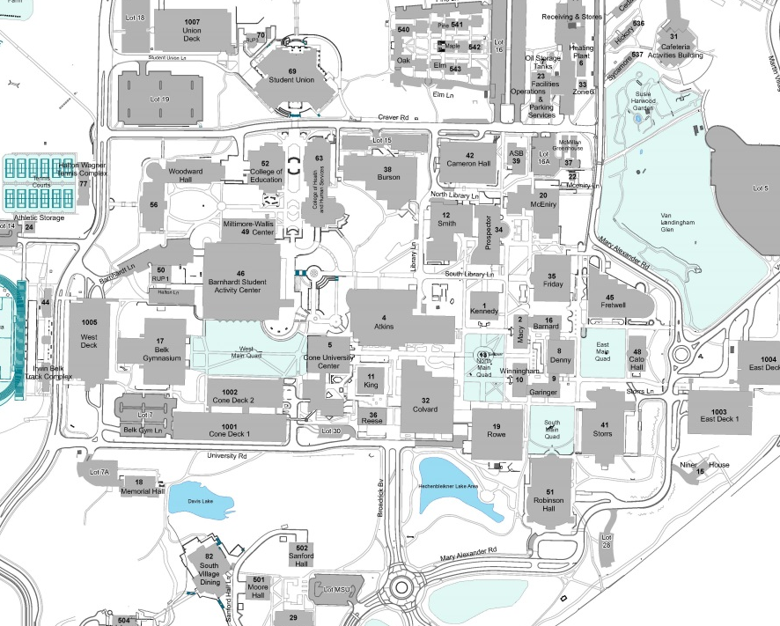
Map

