Slide 1

Job Order Contracting
Informational Seminar
JULY 2018

Slide 2
Agenda
JOC Overview
JOC Process
JOC Contract Documents
Benefits of JOC to Contractors
Misc.
Questions

Slide 3
JOC Overview
Job Order Contracting is an Indefinite Quantity Construction Contract
JOC Introduced in the United States in 1985
  Dept. of Defense, USPS, NASA, etc.
Implemented by states, counties, cities, K-12 schools, universities, housing authorities, etc. since 1990
Hundreds of contracts currently in use
Over $1.4 Billion in construction placed annually through Gordian JOC systems

Slide 4
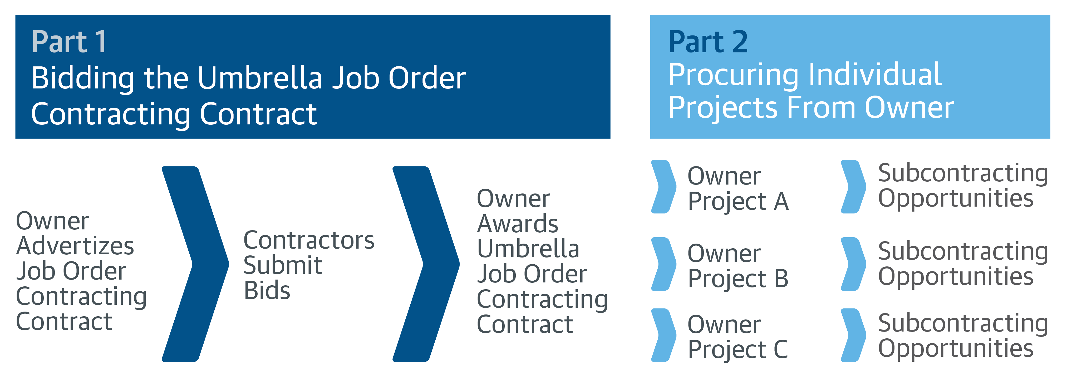
JOC is an Umbrella Contract

Slide 5
JOC Is an Umbrella Contract
  At this time, the University Cannot
  Identify or Commit to any Specific Project or Location
  Identify or Commit to any Specific CTC Tasks or Quantities
Base Term with Option Periods
Minimum Contract Value
Maximum Contract Value
Contractor Performance Drives Volume of Work
Notes:
5

Slide 6
How is JOC Bid?
  Award Based on an Best Value through a Request for Proposal
  Technical Factors and Price
  Lowest Price Based on Proposed Adjustment Factors
    Normal Working Hours
    Other than Normal Working Hours
  Each Adjustment Factor is Weighted
  Contractor with lowest, responsive, responsible bid is deemed to be the low bidder
Notes:
6

Slide 7

Process - How is Work Done?
Joint Scope Meeting With the University, Contractor, and Others to define the Detailed Scope of Work
The University Issues Price Proposal Request for the Agreed Upon Detailed Scope of Work
Proposal Development
  Typical Proposal Due Date will be 2 weeks from Price Proposal Request
Proposal Review
Issuance of Job Order
Total Time Goal: Average 3-5 weeks
Notes:
7
11

Slide 8
JOC Overview – Contractor Benefits
  Why JOC Works for Contractors
  Good work is rewarded with more work
    Profit is a function of volume
    Volume is driven by performance
    JOC provides a steady flow of work
    Do not have to chase the next project
  Long-term relationship with the University
    Good work is rewarded with more work
    Develop partnership with the University
  Reduced Risk
    Payment for every element of work performed
    Ability to provide input during scope development
Notes:
8

Slide 9
JOC Overview – Subcontractor Benefits
  Why JOC Works for Subcontractors
  Responsiveness requires local prime presence and use of multiple local subcontractors.
  Wide range of possible projects means variety of subcontractors will be needed to fulfill the contract.
  Simplified procurement process for the University allowing them to procure more work in a shorter period of time. Results in greater number of subcontractor opportunities
  Multiple projects on multiple sites simultaneously.
Notes:
9

Slide 10
JOC Overview
Why JOC Works for the University
  A Fixed Priced, Fast Track Procurement Process
  Job Orders are Lump Sum
  The Ability to Accomplish a Substantial Number of Individual Projects with a Single Competitively Bid Contract
  On-Call Contractors Ready to Perform a Series of Projects at Different Locations for Competitively Bid Prices
  Contractor Has A Continuing Financial Incentive To Provide
    Responsive Services
    Accurate Proposals
    Quality Work on Time
    Timely Close Out
    Meet or Exceed HUB Participation Goals
  Future Purchase Orders Tied to Contractor Performance
    No Obligation To Award Specific Projects
    University can Use All Other Methods For Accomplishing Projects

Slide 11
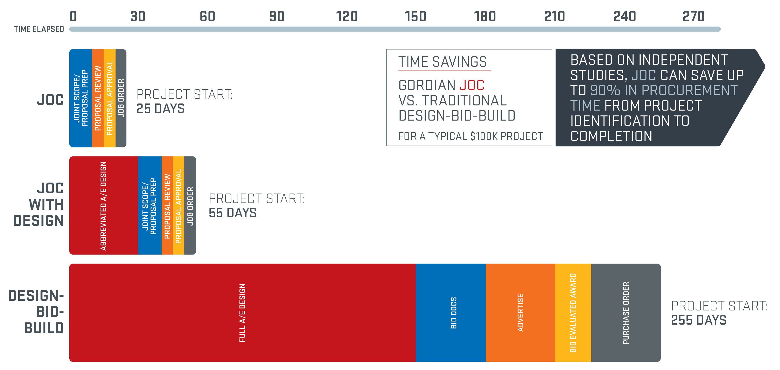
JOC Overview - Efficiency
Time Savings
  Faster Procurement = Weeks Instead of Months
  Based on Owner-Contractor Partnership = Non-Adversarial Relationship
Notes:
11

Slide 12
JOC Overview – Additional Benefits
The University can also Use JOC to
  Increases Transparency
    The University Has the Ability to See and Review the Back-Up Pricing Details
  Schedule Flexibility
    No Shelf Life for Prices or Job Orders
    Fast procurement cycle is good for end of fiscal year projects
Notes:
12

Slide 13
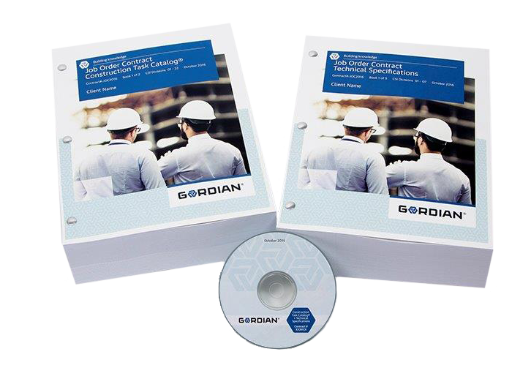
JOC Contract Documents
University’s Traditional Request for Proposal Document
Construction Task Catalog®
Technical Specifications
Notes:
13
6

Slide 14

JOC Contract Documents
Traditional Invitation for Bid
  Contract Overview & Details
  Submittal Requirements
  Instructions to Bidders
  Attachments to be Submitted with the Bid
  Terms and Conditions
  Bond Requirements
  Warranty
  Liquidated Damages
  Changes in the Work
  HUB Guidelines and Goals
Notes:
14
6

Slide 15
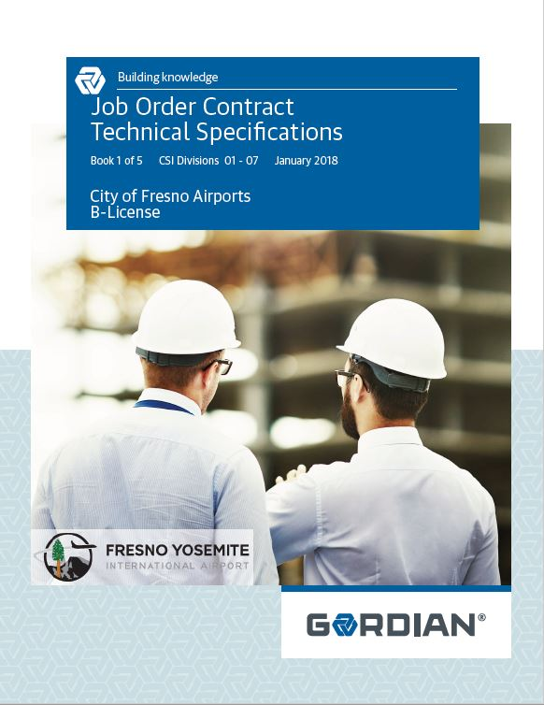
JOC Contract Documents
Technical Specifications
  Specifies Quality of Materials and Workmanship
  Corresponds with Tasks in the Construction Task Catalog®
Notes:
15
8

Slide 16
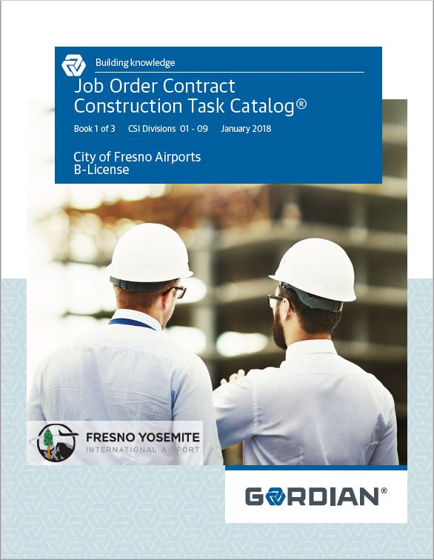
JOC Contract Documents
Construction Task Catalog® (CTC)
  Catalog of Pre-Priced Construction Tasks
  Organized by Construction Specifications Institute (CSI)
  Based on Local Labor, Material & Equipment Costs
  The tasks represent the “Scope of Work” for the JOC Contract
Notes:
16
7

Slide 17
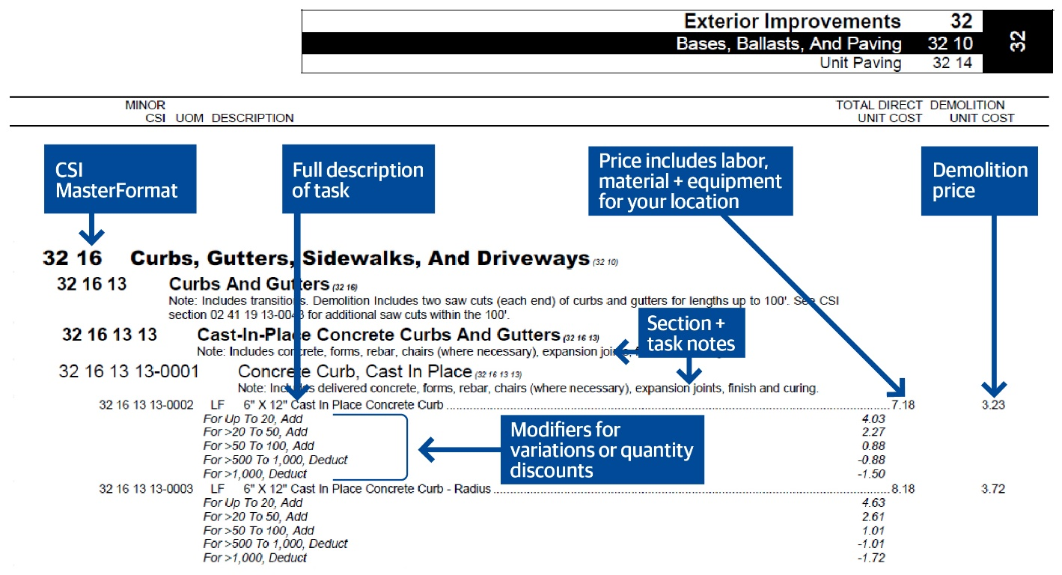
JOC Contract Documents
Construction Task Catalog® (CTC)
  Typical Task:
Notes:
17
7

Slide 18
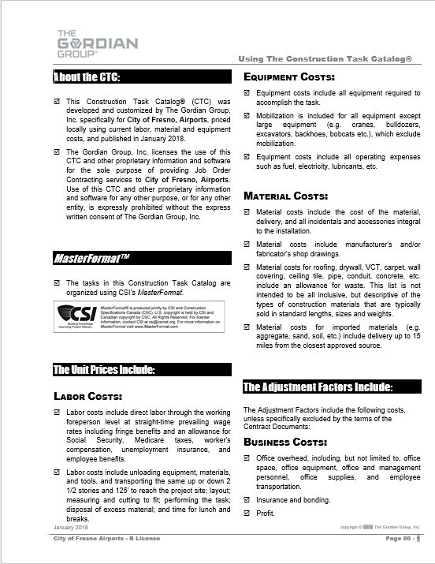
Understanding the
Construction Task Catalog®
Contractor must review and understand “Using the Construction Task Catalog®”
Rules of the game
Make sure you get paid for all appropriate tasks
Pages 00 – 1 to 00-8 of the CTC
* Handout
Notes:
General Rules
Unit Prices are for Complete and In-Place Construction
Unit Prices Include Labor, Material and Equipment. Do Not Add Labor to Task
Unit Prices Include the Cost of Delivery to Site, Unloading, Storage and Handling. Delivery Height is up to 2 ½ Stories
Unit Prices Include Testing, Calibration, Balancing Etc. for New Work
Unit Prices Include all Fasteners, Bolts, Anchors, Adhesives Etc. For New Work
Unit Prices for Tasks Such as Windows, Doors, Frames, Countertops Etc. Include Sealant and Caulk
General Rules
Demo Price Includes Loading into Truck or Dumpster
If Item Demolished as Part of Different Task, It will Not Be Paid for Separately
Contractor Paid for Installed Quantities Only. Waste is Included in Unit Price
Assembly Prices take Precedence over Component Pricing
14’ Working Height for All Work Except Masonry
4’ Working Height for Masonry
Dumpsters are a Separate Task
Contractors Never Get Paid Separately For:
Joint Scope Meetings and Proposal Preparation
Moving and Returning Furniture Occupying Less than 55% of Floor Area. For Example, Moving Classroom Furniture to Paint Room
Labor for Protecting Work in Place. For Example, a Laborer to Stay After a Concrete Pour
Plastic, Drop Clothes, Etc. to Protect Surfaces Not in the Scope of Work
Minor Barricades and Signage.
Portable Toilet, Field Office, Field Office Equipment for Contractor’s Use
Layout, Site Engineering for the Work Itself
Include All Appropriate Tasks:
Mobilization Task for Excavation Equipment, Paving Equipment, Cranes, etc.
Minimum Set up Charges for Core Drilling, Saw Cutting, etc.
Minimum Charge for Small Area Pavement Repairs
Paid Separately for Removing Demolition Material and Waste Material From Site
Scaffolding or Lifting Equipment over 14’ (4’ for Masonry)
Modifiers for Small or Large Quantities
18

Slide 19
Understanding the
Construction Task Catalog®
Include All Appropriate Tasks:
Compare these prices
* Sample only

Slide 20
Non Pre-priced Tasks
Work Tasks not in the CTC
Three (3) Quotes on vendors’ or subcontractors’ letterhead
Justification for less than three (3) Quotes
Markup based on NPP formula

Slide 21
Methods to Calculate the
Adjustment Factors
Recommended Method
Alternative Method
Use Historical Project Data
  Select a Completed Project
    You Know Scope and Direct Costs
  Price Project From CTC
  Add on Overhead and Profit
  Calculate the Adjustment Factor
Create a Representative Project
    Create a Scope of Work
    Get Sub Quotes or Estimate Cost
    Price Project From CTC
    Add on Overhead and Profit
    Calculate the Adjustment Factor
Notes:
21

Slide 22
Sample Project -
Detailed Scope of Work
Renovation
  Doors and Hardware
    Replace 12 interior doors, hinges and hardware
    Doors shall be 3x7, solid core wood doors
    Grade 2 locksets with knobs
    Replace 2 push bar exist devices and door closers on exit doors
  Interior Lighting
    Replace all lay-in troffer fixtures on first and second floors. 48 in total
    Replace 4 exit fixtures
    Replace 12 industrial fixtures in shop area
  Plumbing Fixtures
    Replace 8 bathroom sinks, 8 faucets, and 8 toilets in men’s and women’s bathroom in admin building and shop area
    Replace 4 water fountains
  Replace Boiler
    Demo existing boiler and as much piping and venting to accommodate new boiler. Install a new 1028 mbh oil fired cast iron boiler. Weil-McLain Model 88. No access for packaged boiler. Must field assemble sections. Provide new piping as required.
  Normal Working Hours Apply
Notes:
22

Slide 23
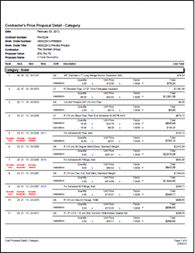
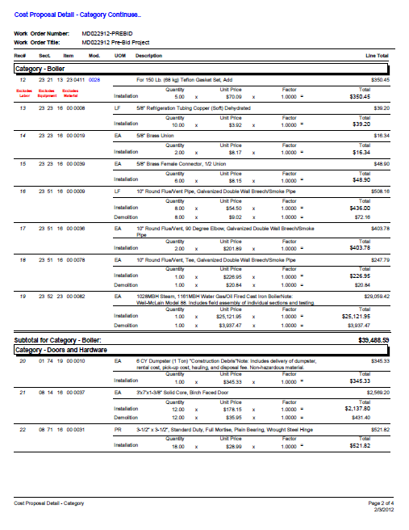
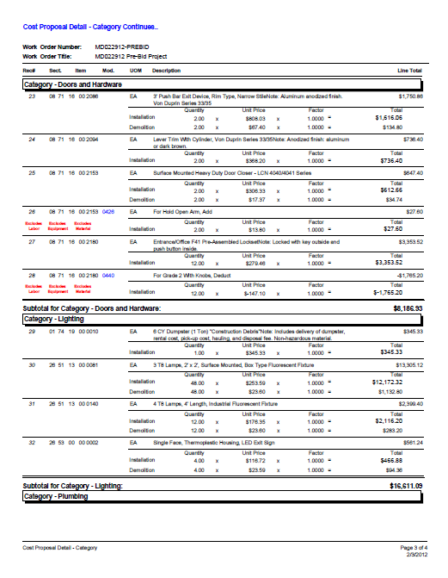
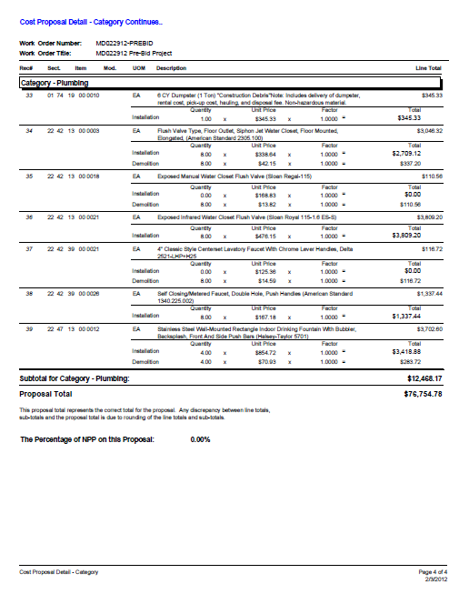
Sample Project – Price Proposal
Notes:
23

Slide 24
Sample Project –
CTC Price vs. Quotes
Direct Cost of Work from Quotes or Estimates
Direct Cost of Work from CTC
Replace Boiler $ 48,911.43
Doors / Hardware $ 9,748.46
Lighting $ 15,845.00
Plumbing $ 14,986.76
TOTAL = $ 89,491.65
Replace Boiler $ 47,500.00
Doors / Hardware $ 9,250.00
Lighting $ 16,750.00
Plumbing $ 12,500.00
TOTAL = $ 89,000.00
Notes:
24

Slide 25
Sample Project –
Putting It All Together
A. Direct Cost of Work from Quotes $89,000.00
B. Overhead 10%* $ 8,900.00
C. Subtotal (Cost & O/H) $97,900.00
D. Profit 10%* $ 9,790.00
E. Subtotal (Cost & O/H & Profit) $107,690.00
F. Price From CTC $89,491.65
Adjustment Factor (= E / F) = 1.2034
*Sample Only. Contractor to determine O/H & Profit.
Prepare this calculation for more than one sample project.
Notes:
25

Slide 26
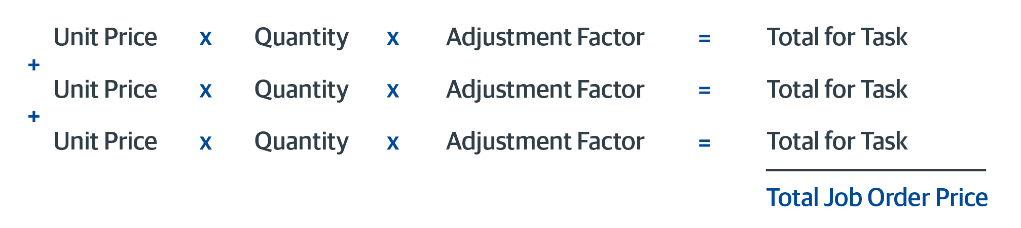
Contractor Adjustment Factor
Importance of Adjustment Factors
  Determines lowest proposed price AND
  Used to price individual Job Orders
  Price Proposal total becomes the lump sum Job Order Price

Slide 27
Contractor Adjustment Factor
Annual Price Adjustment
  Applied annually on the Contract Award’s Anniversary Date
  Based on CCI for average of the twenty cities published by Engineering News Record
  Calculation
    Average CCI for Current Year = The % Increase or Decrease in
      Average CCI for Base Year Construction Costs
    Percentage x Original Adjustment Factors = New Adjustment Factors for Next Year
  Normal Working Hours
  Other Than Normal Working Hours

Slide 28
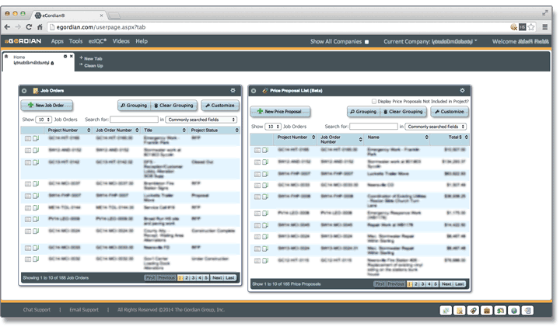
JOC Management Software
Internet Based Software Provided with Contract
  eGordian® Software Expedites the Job Order Process
    Price Proposals
    Subcontractor Lists
    Tracking Dates
    Required Job Order Forms
  Training provided
Notes:
28
22

Slide 29
Questions and Discussion
Notes:
29
22

