Slide 1

Open-End Services
Wednesday, February 8, 2017
Facilities Management

Slide 2
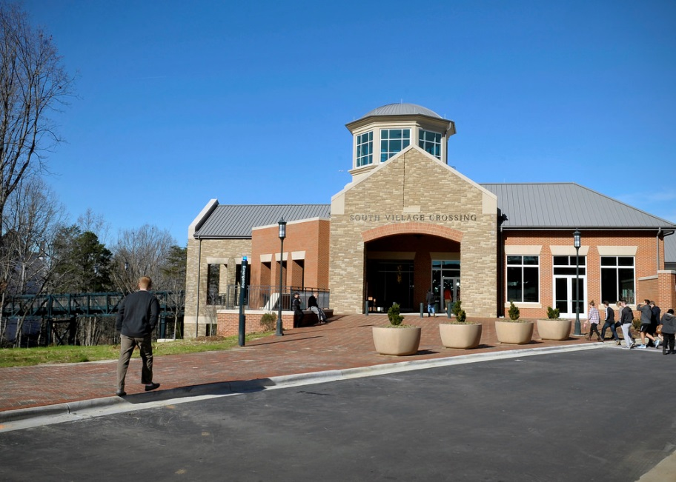
Agenda
Welcome – John A. Fessler, PE, Director
The Process – SF 330
The Past
The Schedule (contract FY)
The Chairs
The Project Managers
Questions

Slide 3
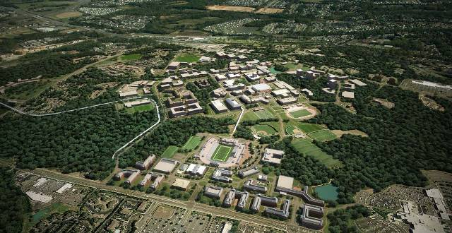
The Process
Overview (John A. Fessler, Director, Capital Projects)
  Advertise, Review, Recommend, Select, Notify
  SF 330—Be specific, limited 30 pages
  Qualifications Based Selection (QBS)
  General Statute 143-64.31

Slide 4
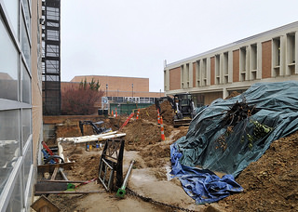
The Process
SF 330
Follow directions
  Number of copies
  Page length
  CD (one file pdf file please)
Winners
  Proven experience in category (the team)
  Local
  New faces

Slide 5
The Process
QBS
Our Team
  PE / AIA Chair
  Project Managers (two)
Your Team (workers not overhead)
  Appropriate expertise
  Past performance
  Proximity to campus
  Familiarity to local area
  Adequate staffing levels

Slide 6
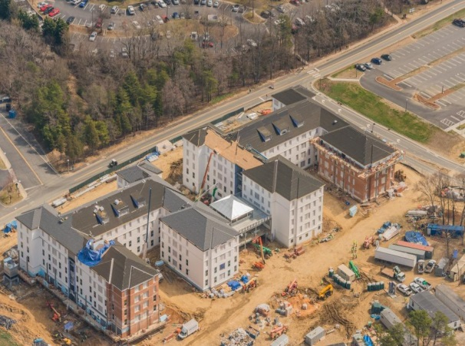
The Past
2015/16—Fee total ($282,267)
  Architecture--$69,261 (20 received, picked 4)
  Civil Engineering--$94,646 (22 received, picked 5)
  Constr. Services--$22,520 (12 received, picked 3)
  MEP--$95,840 (10 received, picked 3)
  Surveying--$0 (5 received, picked 2)
  Commissioning--$0 (6 received, picked 2)

Slide 7
The Past
2014/15—Fee total ($809,469)
  Architecture--$349,027 (31 received, picked 7)
  Civil Engineering--$244,616 (25 received, picked 3)
  Constr. Services--$80,781 (13 received, picked 4)
  MEP--$126,370 (15 received, picked 4)
  Surveying--$8,675 (13 received, picked 3)
  Commissioning--$0 (8 received, picked 1)

Slide 8
The Past
2013/14—Fee total ($824,624)
  Architecture--$321,447 (27 received, picked 8)
  Civil Engineering--$227,417 (30 received, picked 6)
  Constr. Services--$80,770 (18 received, picked 3)
  MEP--$194,990 (22 received, picked 4)
  Surveying--$0 (11 received, picked 4)
  Commissioning--$0 (12 received, picked 2)

Slide 9
The Past
2015/16—Fee total $282,267 (6 categories)
2014/15—Fee total $809,469 (6 categories)
2013/14—Fee total $824,624 (6 categories)
2012—Fee total $1,006,051 (7 categories)
2011—Fee total $553,225 (7 categories)
2010—Fee total $1,119,168 (7 categories)
2009—Fee total $500,835 (7 categories)

Slide 10
The Schedule
Jan 18 Post Advertisement
Feb 8 Mandatory Pre-proposal meeting
Feb 22 SF 330 due
Feb 28 Committee Chairs meet
Mar 28 Committee recommendations
April 3 Recommendations reviewed by senior staff
April Board of Trustees approval
May Notification to firms

Slide 11
The Chairs
Architecture—Chris Gilbert, AIA
Civil Engineer/Site—John Fessler, PE
Commissioning—Tom Sparks, PE
Construction Services—Jennifer Price, PE
MEP—Tony Schallert, PE
Surveying—Jeanine Bachtel, PE

Slide 12
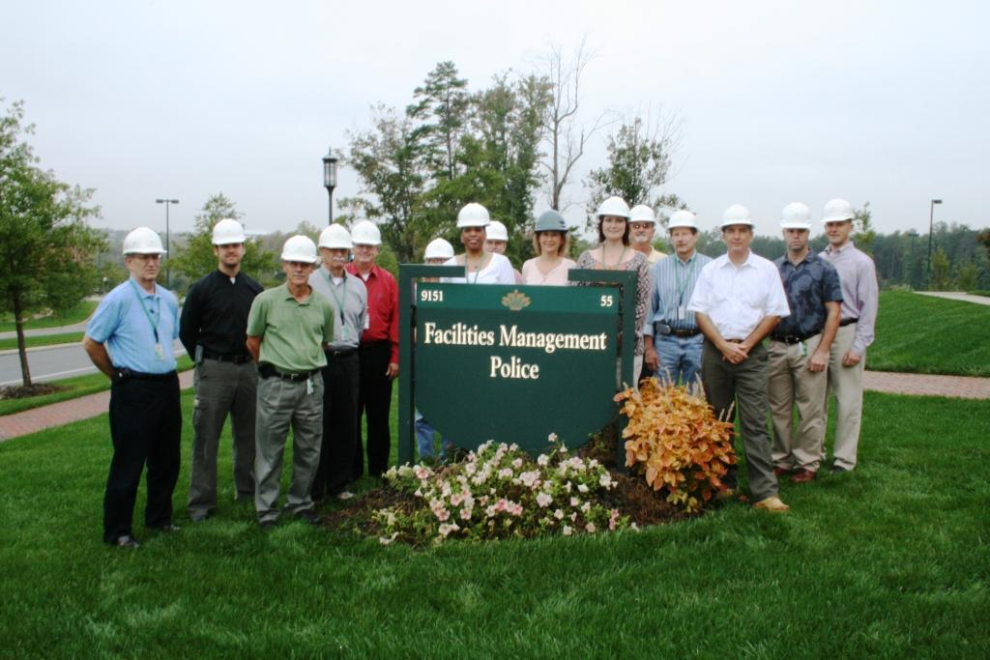
Project Managers
Design Services
  Mac Fake, John Boal, Steve Terry, David Love
  Amanda Caudle
Architectural Planning
  Chris Gilbert, Nick Patel
Capital Projects
  John Fessler, Jeanine Bachtel, Lisa Lanier, Brian Kugler,
  Elizabeth Frere, Donia Schauble, Tom Sparks,
  David Daignault, Tony Schallert, Peter Franz

Slide 13
Questions
Civil Engineering/Site—provide all services?
Should each submittal include all sub-services listed
in parentheses?
If we could not provide all services in-house, should
we compile a team to cover all?
Teaming due firm’s services—if needed
Cover sheet does not count to 30 page limit

